Slide 1
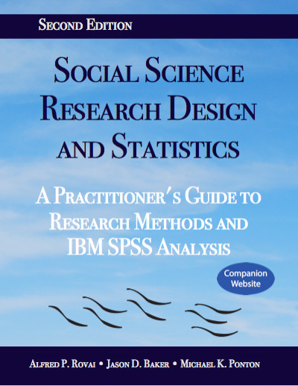
Social Science Research Design and Statistics, 2/e
Alfred P. Rovai, Jason D. Baker, and Michael K. Ponton
Partial Correlation
PowerPoint Prepared by
Michael K. Ponton
IBM® SPSS® Screen Prints Courtesy of International Business Machines Corporation,
© International Business Machines Corporation.

Slide 2
Uses of the Partial Correlation
Determine the correlation between two variables after removing the influence of (i.e., controlling for) at least one other variable.
Test the hypothesis that there is no linear relationship between two variables in the population after controlling for at least one other variable (e.g., zero correlation in the population between variables 1 and 2 controlling for variable 3; ρ_{12.3} = 0).

Slide 3
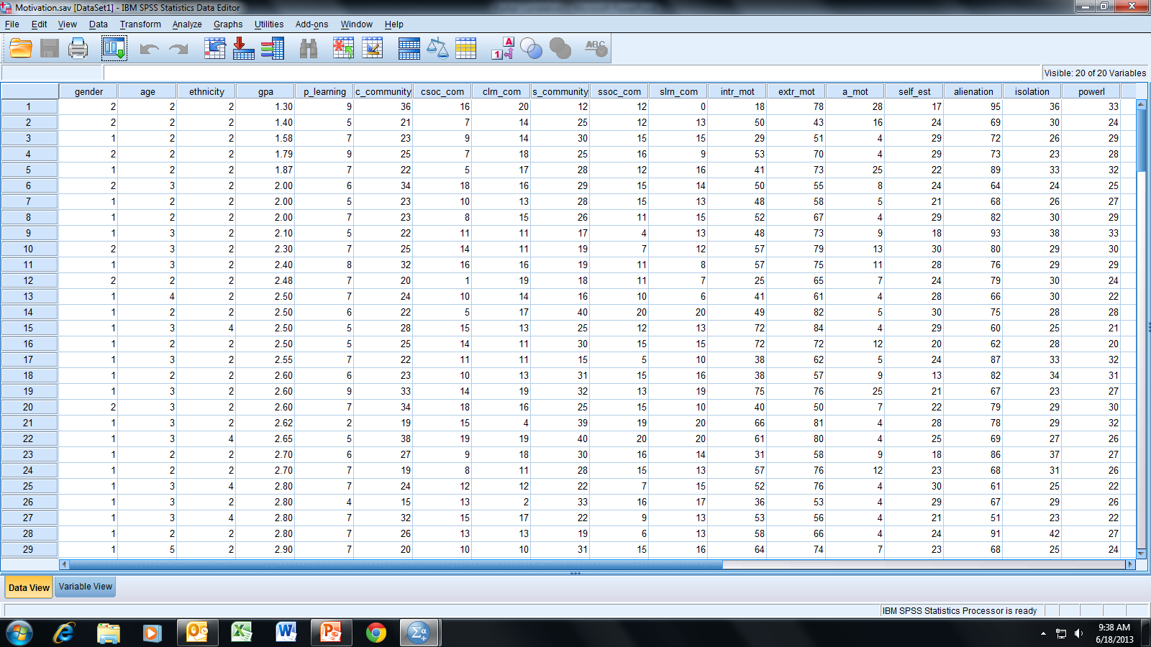
Open the dataset Motivation.sav.
File available at http://www.watertreepress.com/stats

Slide 4
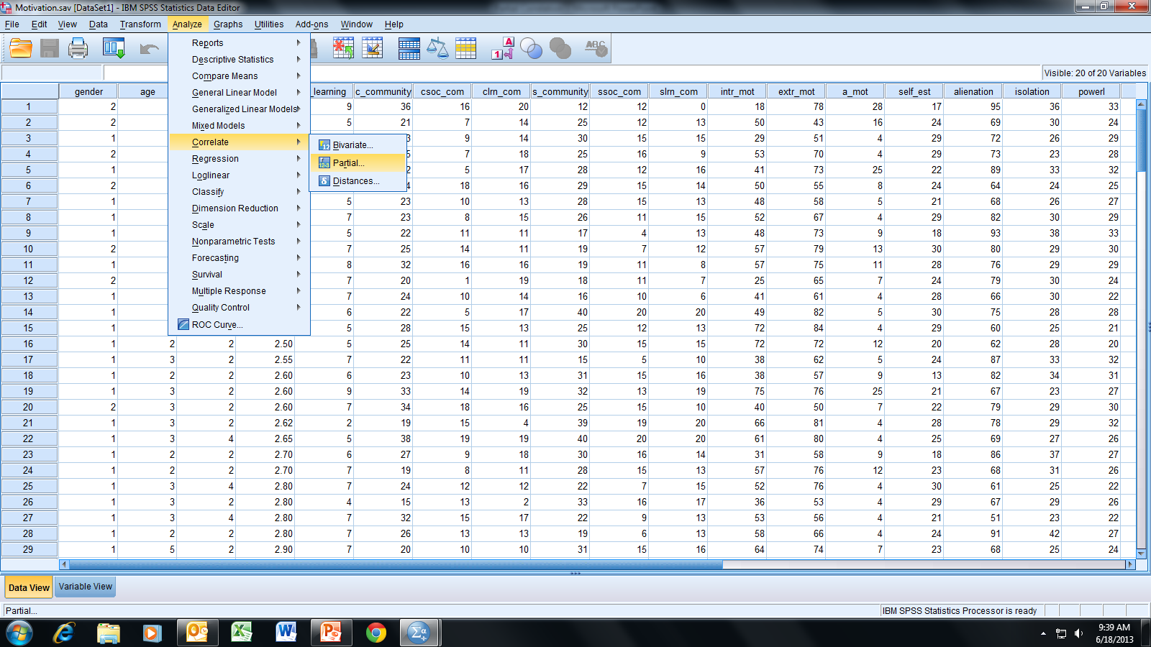
Follow the menu as indicated.

Slide 5
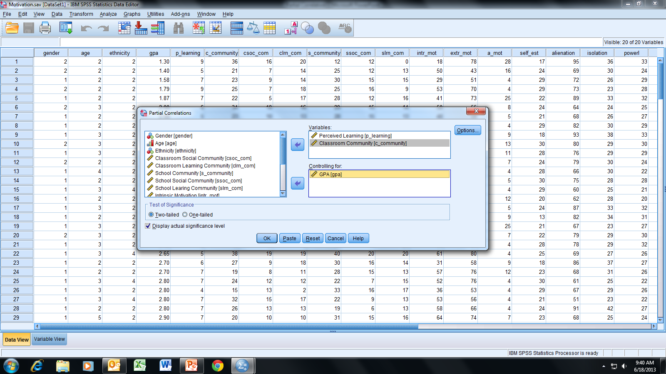
In this example, we will test the following null hypothesis:
H_{o}: There is no linear relationship between perceived learning
and classroom community in online students (variables 1 and
2) after controlling for a third variable GPA (i.e., ρ_{12.3} = 0).
Select and move Perceived Learning [p_learning],
Classroom Community [c_community], and GPA [gpa] to the
appropriate boxes as indicated; click OK.

Slide 6
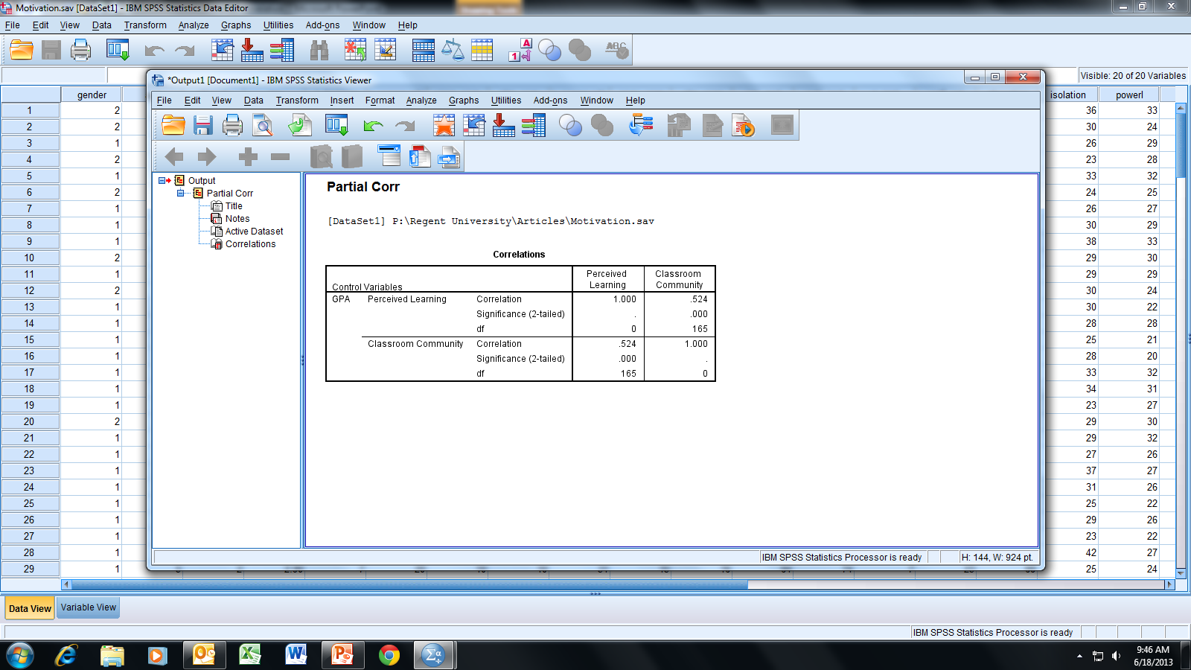
We will choose α = .05 for a two-tailed test (i.e., we are interested if the
partial correlation is either positive or negative). The significance value of “.000”
indicates a significance level < .001, which is less than .05; therefore, we reject
H_{o} and conclude that there is a statistically significant relationship between
perceived learning and classroom community after controlling for GPA.
Note that the partial correlation is positive thereby indicating a direct
relationship between perceived learning and classroom community.

Slide 7
End of Presentation

